Slide 1




VPNs in 2023
Ondřej Šika
ondrej@sika.io
@ondrejsika
jOpenSpace 2023, Telč, 7. 10. 2023

Slide 2

Ondřej Šika
I'm a DevOps engineer and consultant from Prague.
I help companies to set up or improve DevOps to deliver easier, faster and more reliable software products.
I have also popular DevOps training.

Slide 3
Do you need a VPN? 🤔

Slide 4
You don't!

Slide 5


Slide 6

Cloudflare Access
Secure VPN alternative
Identity based Cloudflare Proxy
Zero trust model
Identity based authentication
OIDC (Okta, Keycloak)
Google, Microsoft
Email

Slide 7
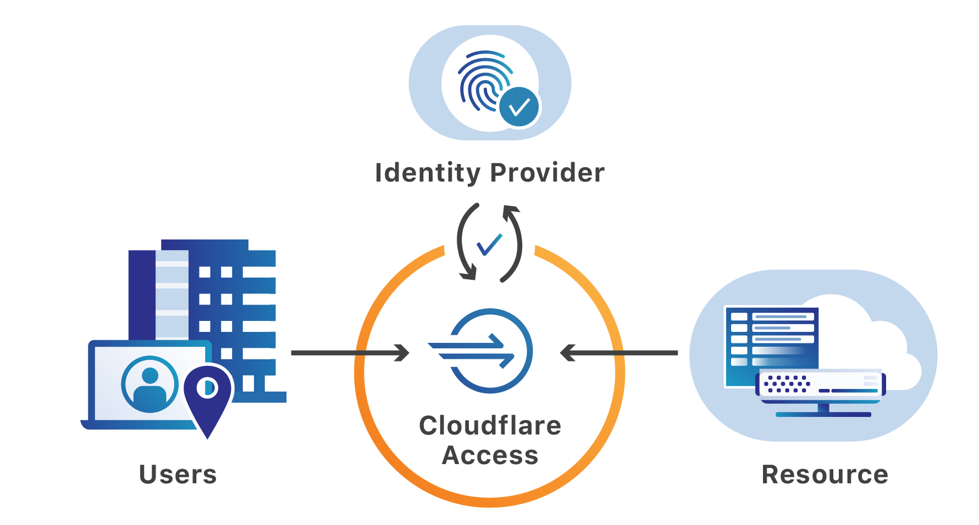

Slide 8
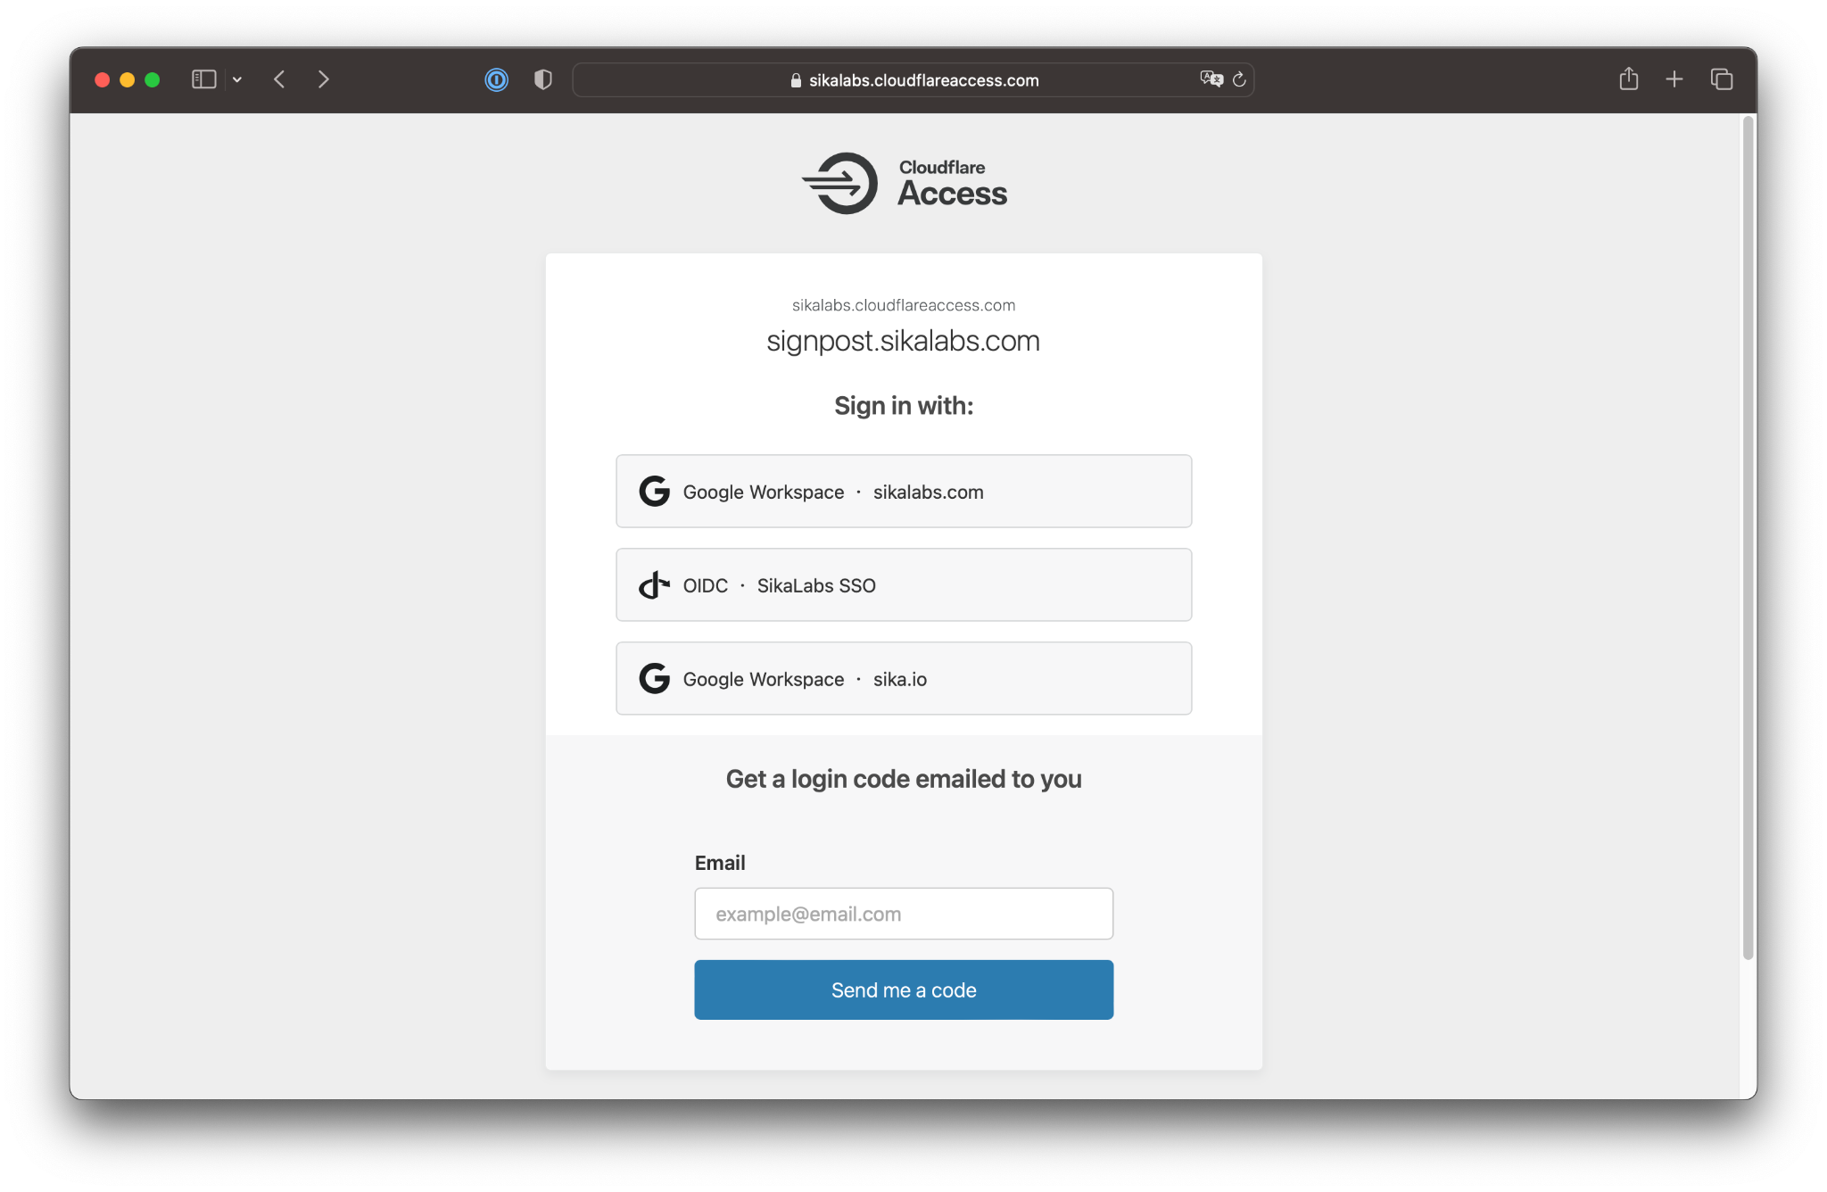

Slide 9
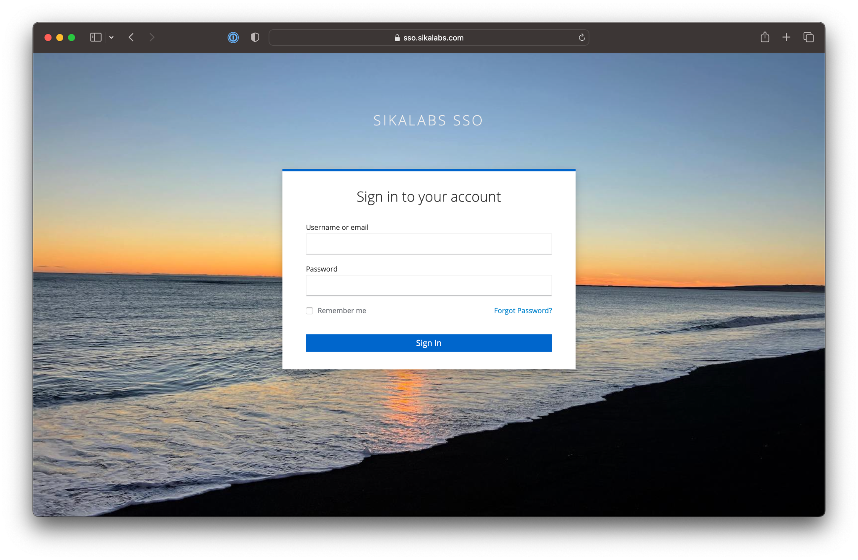

Slide 10
Open Source alternatives?

Slide 11
HashiCorp Boundary
oidc2-proxy

Slide 12
What if we really need a VPN?

Slide 13


Slide 14
What is WireGuard?
Great alternative to OpenVPN & IPSec
Modern, Simple & Robust
Cross Platform
Roaming support
Open Source GPLv3

Slide 15
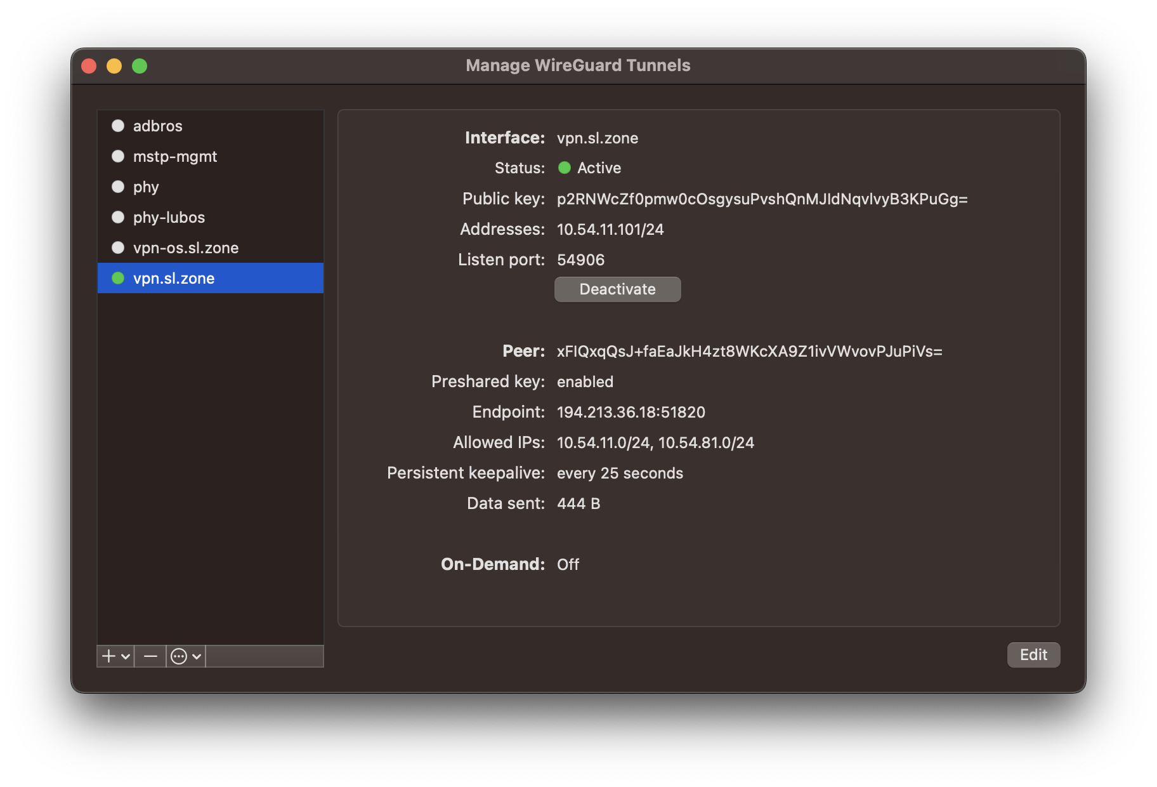

Slide 16
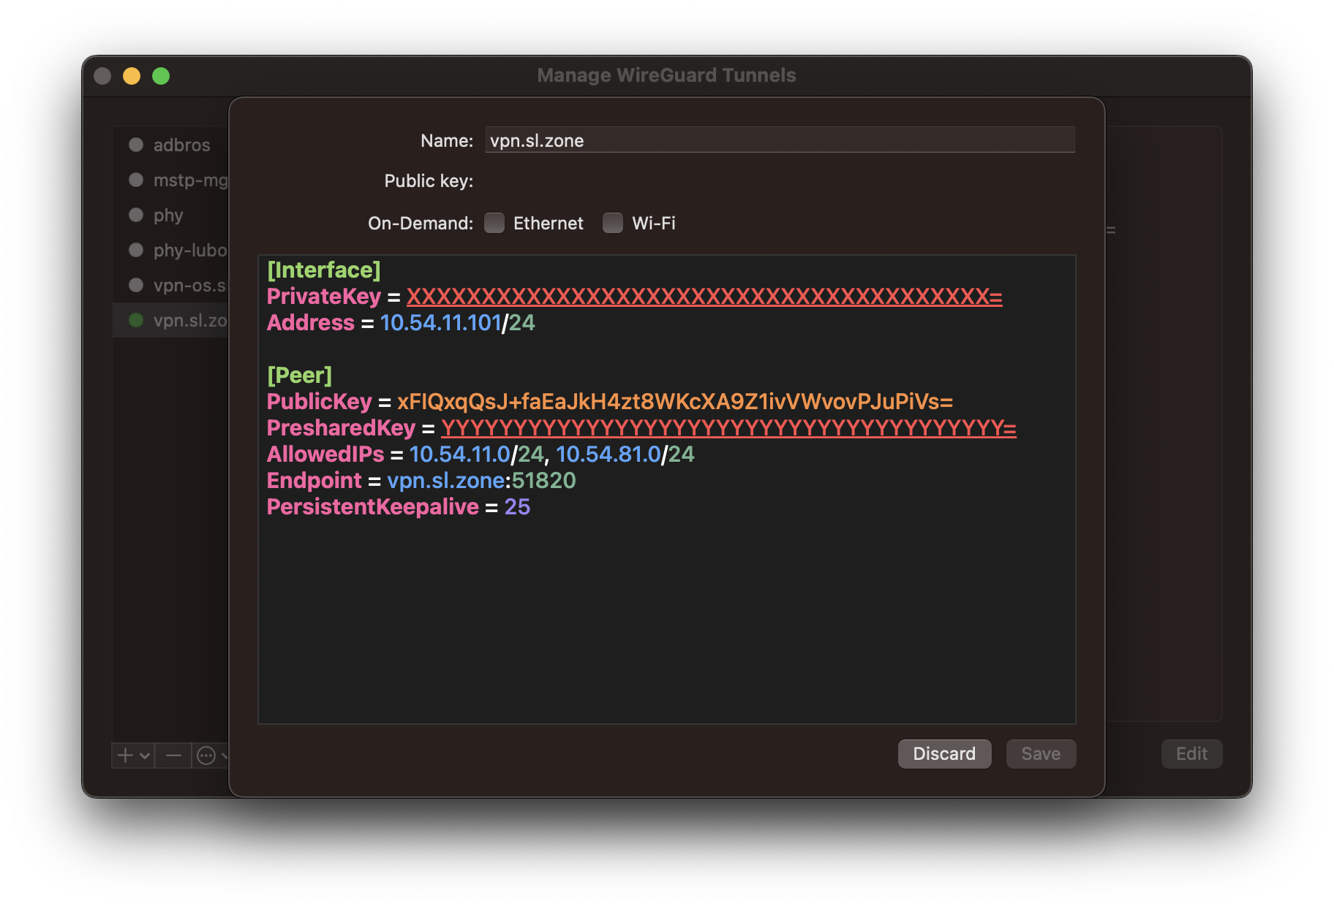

Slide 17
But WireGuard is not so user friendly… 😔

Slide 18


Slide 19
What is Tailscale
Modern managed VPN solution
WireGuard based
Identity based authentication
6 USD / user / mo (3 free users, 100 devices)
Serverless VPN (managed relay servers)
ACL
API & Terraform
Open Source Clients, Open Communication
Great Docs & Blog

Slide 20
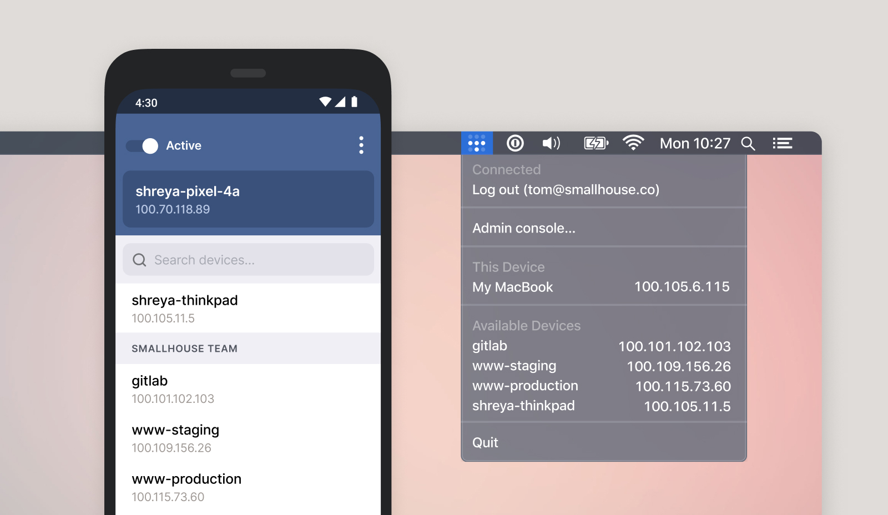

Slide 21
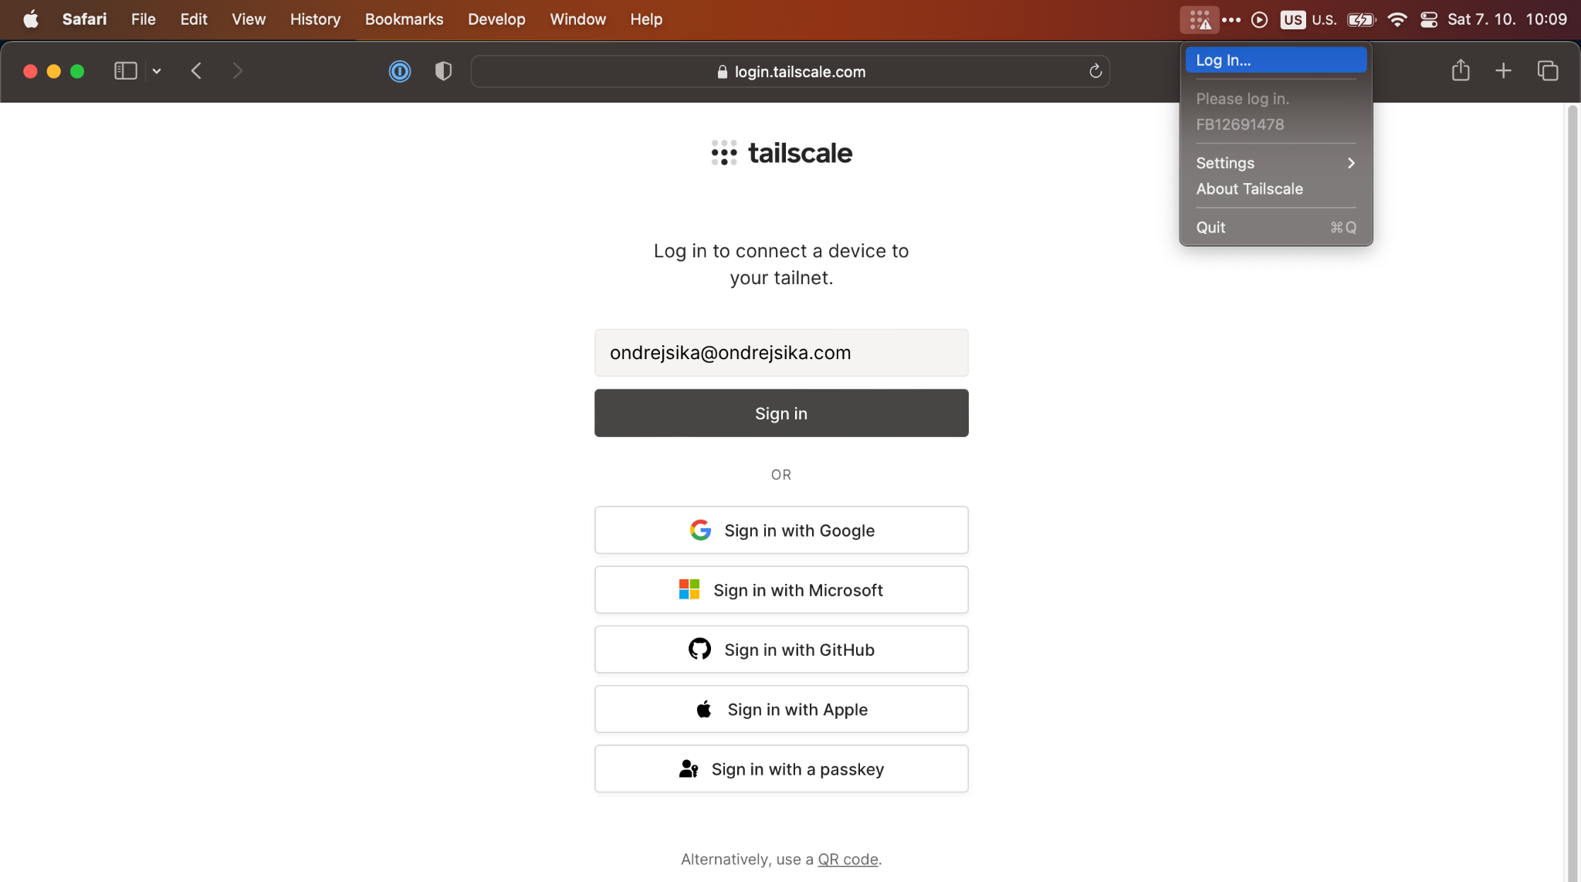

Slide 22
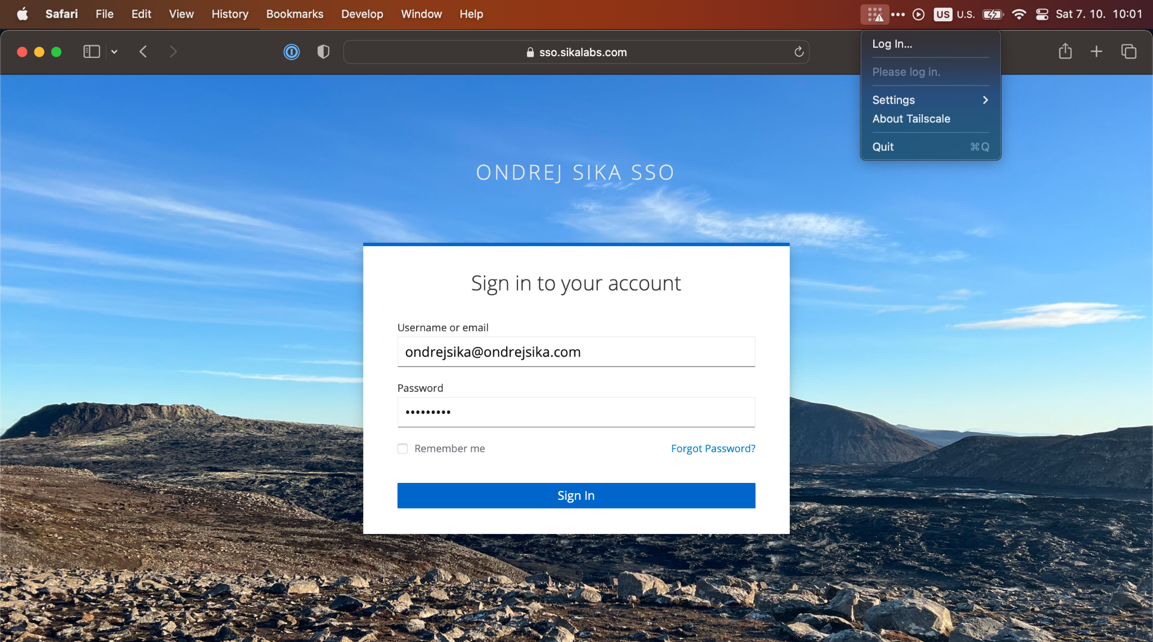

Slide 23
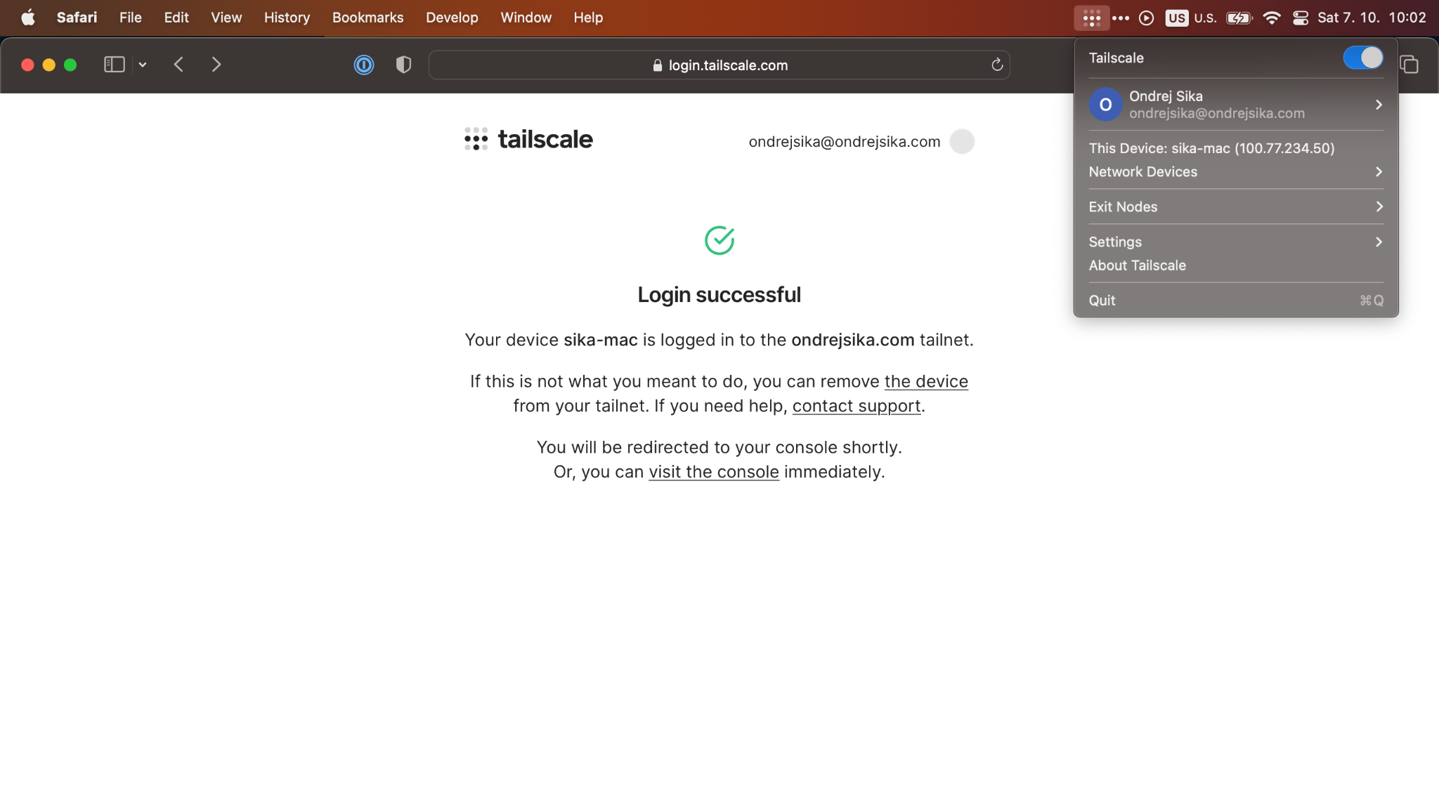

Slide 24
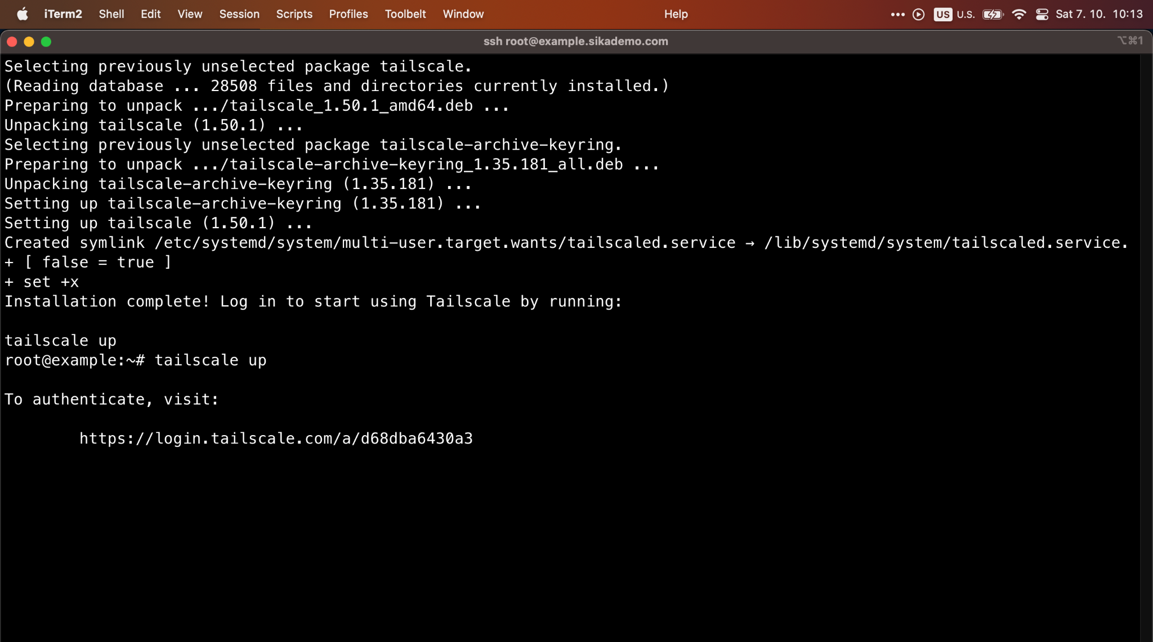

Slide 25
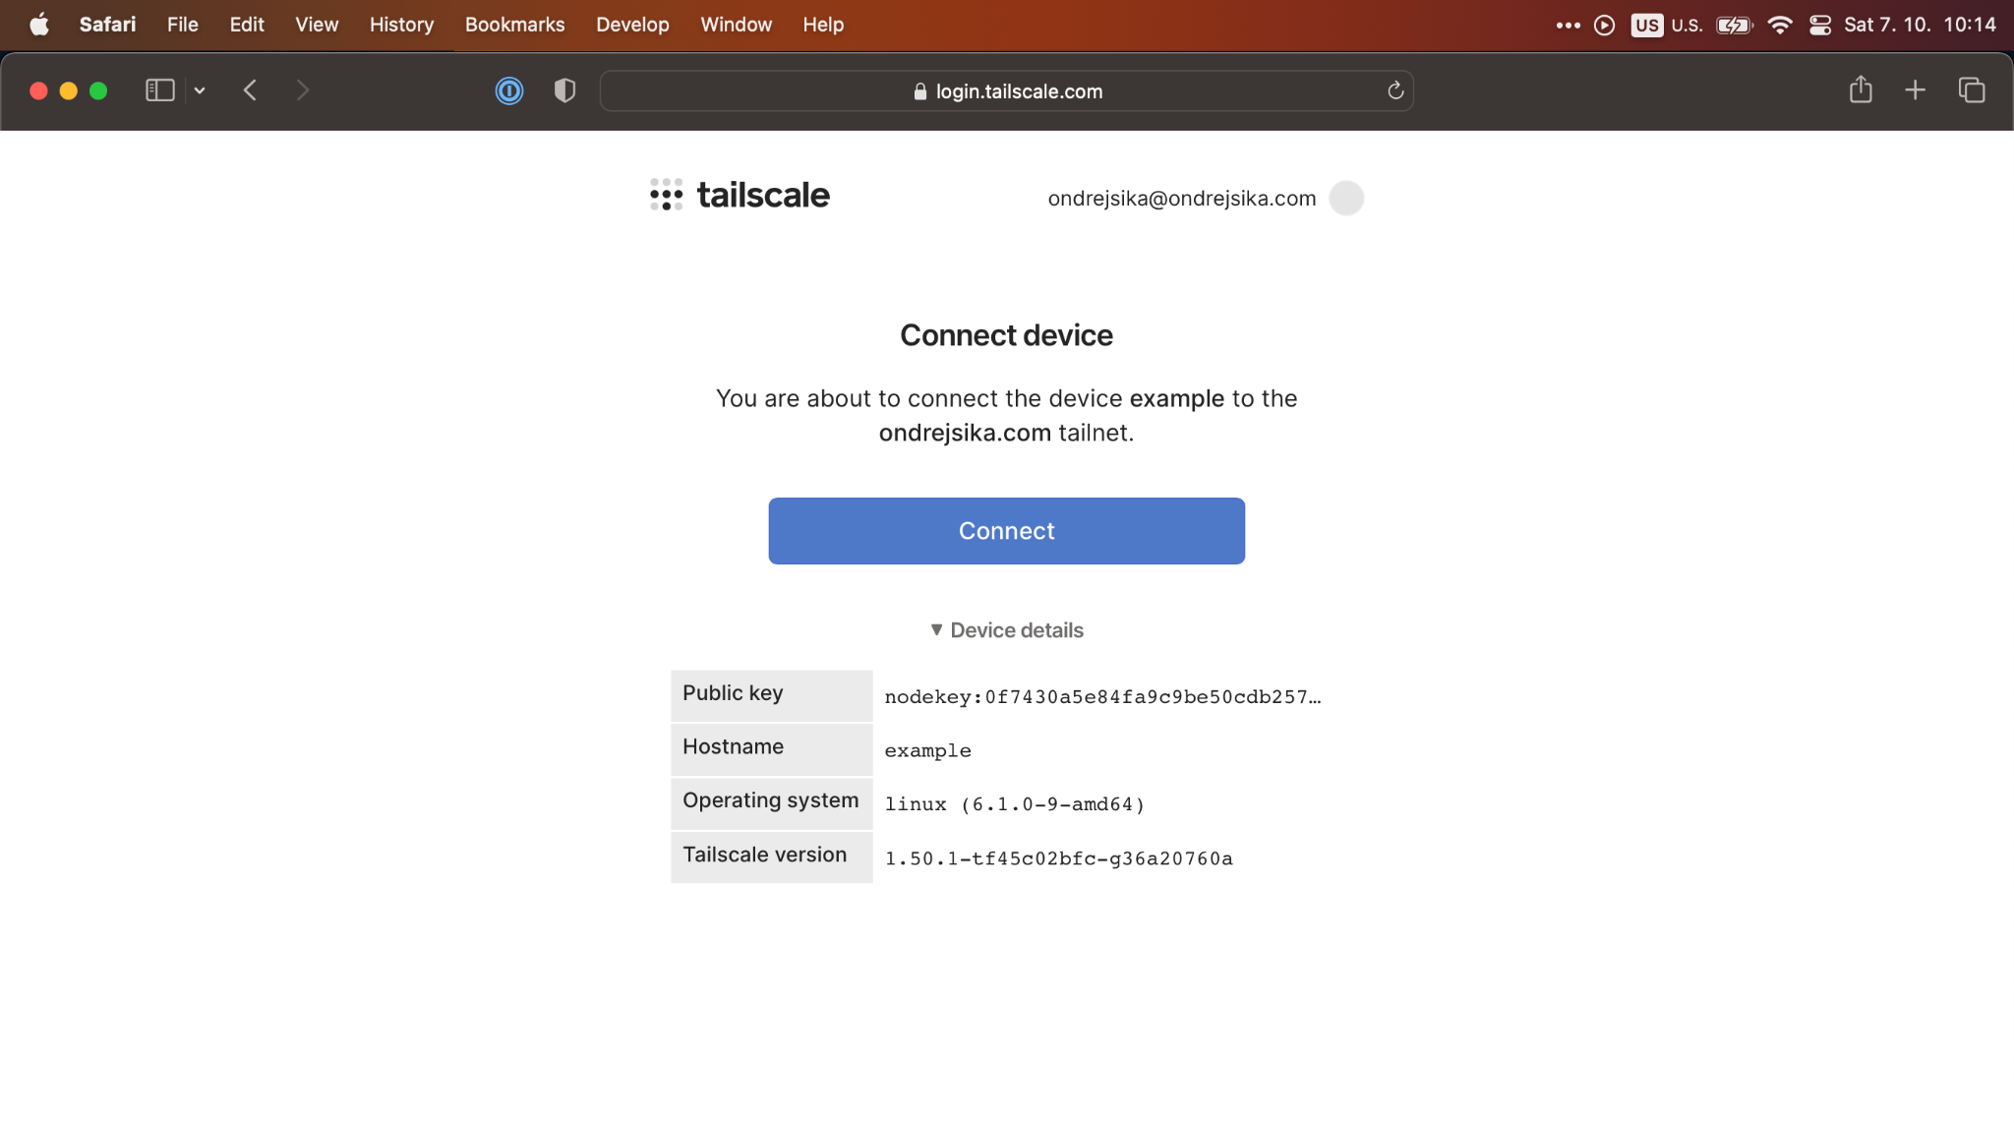

Slide 26
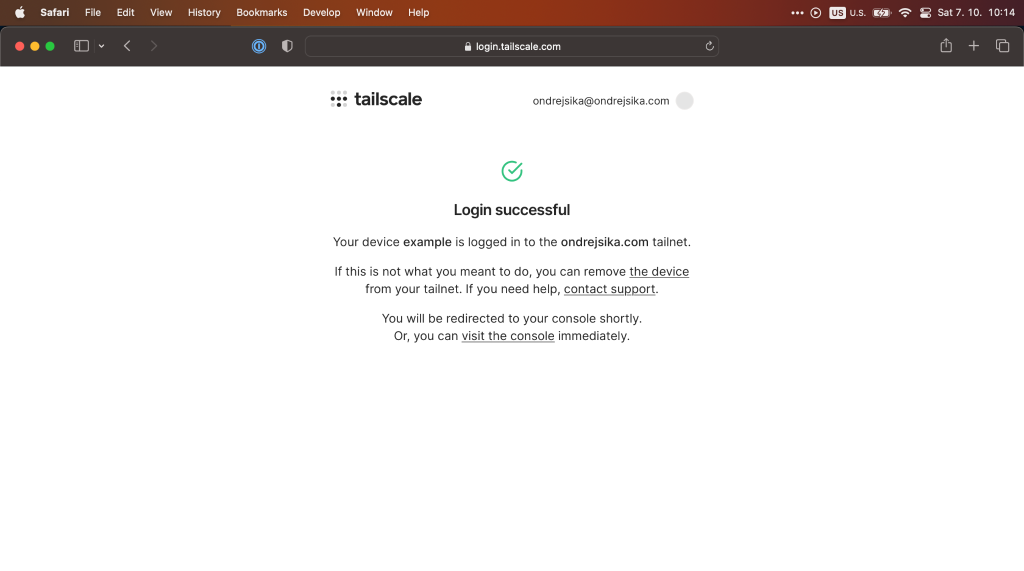

Slide 27
Open Source Tailscale?

Slide 28


Slide 29
What is Headscale
Open Source management server for Tailscale
Same features like Tailscale (except for relays)
No UI (but there are third party UI projects)
Use official Tailscale clients
tailscale up --login-server https://vpn.sl.zone

Slide 30
Díky za pozornost

Slide 31
Otázky?

Slide 32
Email ondrej@sika.io
Twitter
@ondrejsika
LinkedIn
/in/ondrejsika
Slides
sika.link/slides

